Slide 1
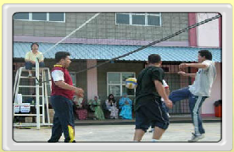
RESPIRATION
https://www.youtube.com/watch?v=6L-WhdPBaiE

Slide 2
Four Respiration Processes
Breathing (ventilation): air in to and out of lungs
External respiration: gas exchange between air and blood
Internal respiration: gas exchange between blood and tissues
Cellular respiration: oxygen use to produce ATP, carbon dioxide as waste

Slide 3
10.1 THE RESPIRATION PROCESS IN ENERGY PRODUCTION
LEARNING OUTCOMES:
State that all living processes require energy
Identify the main substrate for producing energy
State 2 types of respiration
Explain what cellular respiration is
Explain energy production from glucose during the process of aerobic respiration
State the conditions leading to anaerobic respiration in cells
Explain the process of anaerobic respiration in yeast and human muscles

Slide 4
10.1 THE RESPIRATION PROCESS IN ENERGY PRODUCTION
LEARNING OUTCOMES…….
Write the chemical equations for aerobic and anaerobic respiration
Compare and contrast aerobic respiration and anaerobic respiration

Slide 5
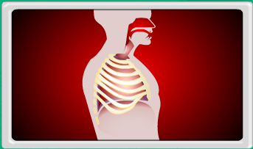
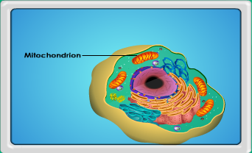
REQUIREMENT OF ENERGY
Respiration is important living process that occurs in 2 main stages:
External respiration / breathing
Internal respiration / cellular respiration

Slide 6
2. External respiration ??
Is a mechanical process of taking air into the lungs and vice versa
Internal respiration ??
Is a biochemical process that occurs in living cells to release energy in the form of ATP
4. Respiration is a process to obtain energy by organisms / living things

Slide 7
All living processes that take place in the body Require energy for ???
muscular contraction
active transport of biochemical substances
transmission of nerve impulses
synthesis of proteins
cell division

Slide 8
Main substrate is GLUCOSE
Green plants capture & store energy of sunlight in GLUCOSE through photosynthesis
For human and animals, GLUCOSE obtained from digestion of Carbohydrate

Slide 9
What is cellular respiration
Is the process of oxidising glucose molecules to CO₂, water and energy in form of ATP
Energy is released during cellular respiration.
2 types of cellular respiration:
AEROBIC RESPIRATION
ANAEROBIC RESPIRATION

Slide 10
AEROBIC RESPIRATION
Requires O₂
Chemical equation:
C₆H₁₂O₆ + 6O₂ → 6CO₂ +6H₂O + E (38 ATP or 2889 KJ)
Occurs in mitochondria (muscle)
Most of energy released, used to synthesise ATP from ADP and phosphate.

Slide 11
ATP, consists of phosphate bonds - can easily broken down to release energy when required by the body
ATP → ADP + phosphate + energy

Slide 12
ANAEROBIC RESPIRATION
Does not require O2
During vigorous activities such as running, swimming and cycling we need more O2 to be delivered to the muscle cells to produce more energy
When the muscle cells have used all the available O2 supply, muscle cells carry out anaerobic respiration

Slide 13
Anaerobic respiration is a process used to produce energy stored in glucose without using O2.
Occurs in cytoplasm

Slide 14
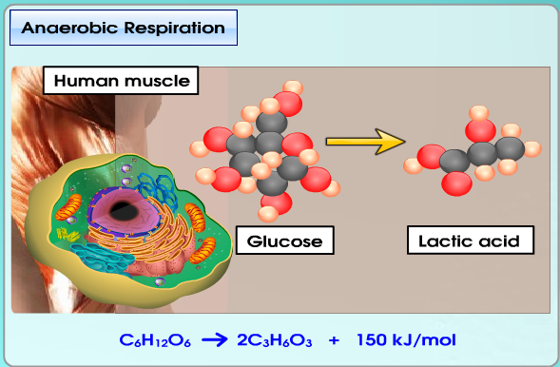
Prolonged physical activities such as running, rate of respiration and rate of heartbeat increase

Slide 15
Muscles are in a state of oxygen deficiency or oxygen debt
So glucose molecules breakdown partially to lactic acid
Due to incomplete breakdown of glucose, energy released is much less compared to aerobic respiration.
Most of energy is still trapped within the molecules of lactic acid

Slide 16
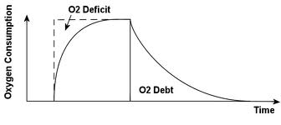
Chemical equation for anaerobic respiration:
For every glucose molecules, only 2 ATP or 150 KJ of energy produced compared to 38 ATP or 2889 KJ energy produced in aerobic respiration
C₆H₁₂O₆ → 2C₃H₆O₃ + ENERGY (150 KJ / 2 ATP )

Slide 17
High concentration of lactic acid may cause muscular cramps and fatigue
So body needs rest and recover by doing fast and deep breathing.
Excess O2 is used to oxidise lactic acid to CO2 and water. Oxidation takes place in liver.
Thus, oxygen demand is the amount of oxygen needed to recover the lactic acid.
Oxygen debt is paid off when all the lactic acid eliminated.
Heart rate is also higher to remove Lactic acid from muscles.

Slide 18
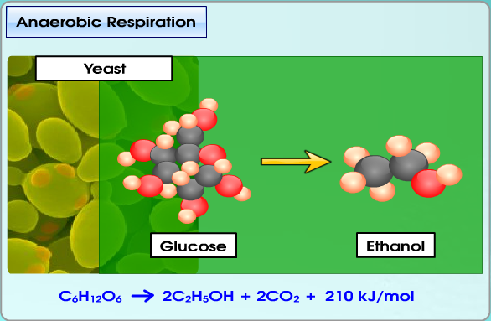

Slide 19
Yeast is able to undergo both aerobic and anaerobic respiration
It carries out aerobic respiration in the presence of O2
Yeast carries out anaerobic respiration when there is a lack of O2 in the environment
Anaerobic respiration in yeast is known as fermentation
Yeast ferments in warm condition to produce CO2

Slide 20
CO₂ bubbles are trapped in the dough and when baked, the CO₂ bubbles give the bread a spongy texture
This anaerobic reaction catalysed by enzyme zymase.
Ethanol can be used in wine and beer production
C₆H₁₂O₆ → 2C₂O₅OH + 2 CO₂ + ENERGY (210 KJ)

Slide 21
COMPARISON BETWEEN AEROBIC AND ANEROBIC RESPIRATION
SIMILARITIES
Cellular respiration
Glucose is used as a substrate
Produce energy
Catalysed by enzymes
Occurs in animals and plants

Slide 22
DIFFERENCES
AEROBIC RESPIRATION | ITEMS | ANAEROBIC RESPIRATION
Almost every living things | Work by | Certain plant cell , yeast , bacteria and muscle
Required | Oxygen requirement | Not required
Complete oxidation | Oxidation of glucose | Incomplete oxidation
CO₂ , water and energy | Product | Lactic acid & energy (muscle) Ethanol , CO₂ & energy (yeast)
Large amount | Energy released | Small amount

Slide 23
DIFFERENCES
AEROBIC RESPIRATION | ITEMS | ANAEROBIC RESPIRATION
Mitochondria | Site | Cytoplasm
C₆H₁₂O₆ + 6O₂ → 6CO₂ + 6H₂O + 2898 KJ | Chemical equation | In muscle cell C₆H₁₂O₆ → 2C₃H₆O₃ + 150 KJ In yeast C₆H₁₂O₆ → 2C₂H₅OH +2CO₂ + 210 KJ
38 molecules | No of ATP | 2 molecules

Slide 24
10.3 RESPIRATORY STRUCTURES & BREATHING MECHANISMS
LEARNING OUTCOMES:
State the respiratory structures in humans
Describe the characteristics of respiratory surfaces in humans
Describe breathing mechanisms in humans

Slide 25
RESPIRATORY STRUCTURES IN SOME ANIMALS
Respiratory structures involved in gaseous exchange:
Across plasma membrane
Tracheal system - insects
Gills - fish
Skin
Lungs

Slide 26
2. To ensure adequate gaseous exchange, respiratory structures of most organisms have common characteristics:
The respiratory surface is moist
Cells lining the respiratory surface are thin
Respiratory structures have a large surface area

Slide 27
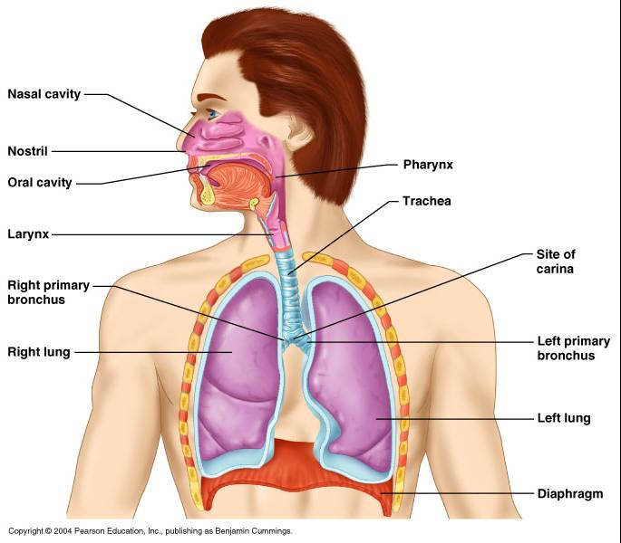
RESPIRATORY STRUCTURE in HUMANs

Slide 28
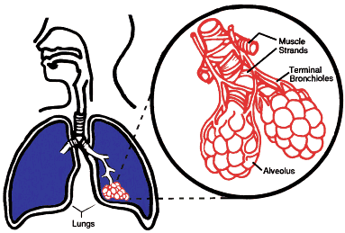
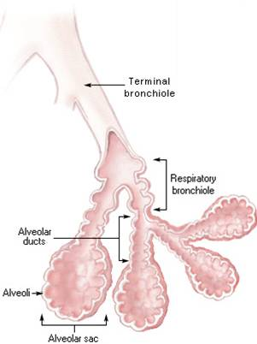
1. Gaseous exchange in humans take place in the lungs
2. Air enters lungs through :
trachea → bronchi → bronchioles → alveoli
3. Trachea is supported by cartilage to prevent it from collapse
during inhalation

Slide 29
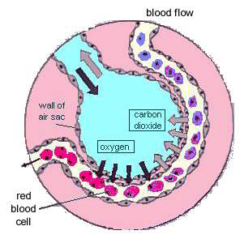
GAS EXCHANGE IN ALVEOLI

Slide 30
FEATURES OF ALVEOLI AND THE FUNCTION IN GASEOUS EXCHANGE
A large number of alveoli in the lungs – increases the surface area for exchange of gases
Walls are made up of a single layer of cells – gases can diffuse easily across the thin walls
Walls secrete a thin lining of moisture – gases can dissolve in moisture and diffuse easily across walls
Surrounded by a network of blood capillaries – can transport O2 to and CO2 away from the cells

Slide 31
10.4 BREATHING MECHANISMS IN HUMANs
INHALATION | EXHALATION
External intercostal muscles contract | External intercostal muscles relax
Internal intercostal muscles relax | Internal intercostal muscles contract
Rib cage move upwards and outwards | Rib cage move downwards and inwards
Diaphragm contracts and flattens | Diaphragm relaxes and returns to dome-shaped
Volume of thoracic cavity increases resulting in reduced air pressure in alveoli | Volume of thoracic cavity decreases resulting in higher air pressure in alveoli
Higher atmospheric pressure outside causes air to rush in | Air is force out of lungs

Slide 32
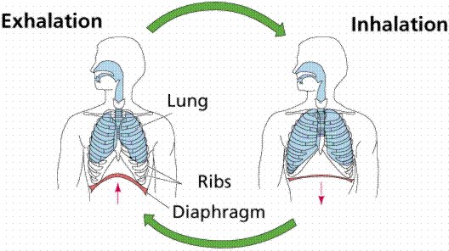

Slide 33
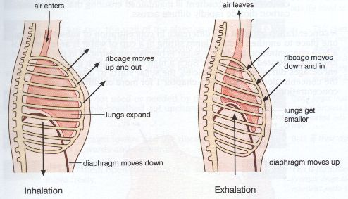

Slide 34
7.3 gaseous exchange across respiratory surfaces & transport of gases in humans
LEARNING OUTCOMES:
Describe process of gaseous exchange across the surface of alveoli and blood capillaries in lungs
Explain the transport of respiratory gaseous
Explain process of gaseous exchange between the blood and body cells
Differences in the composition of inhaled and exhaled air

Slide 35
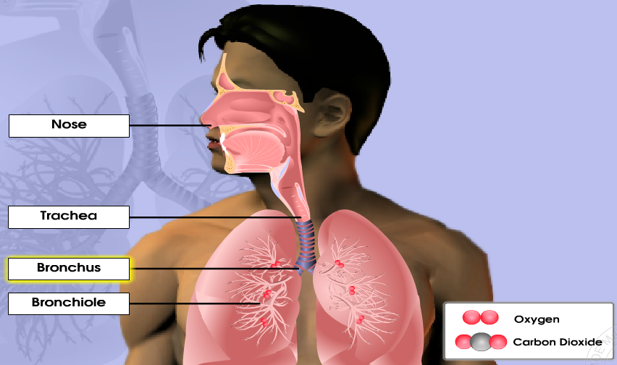
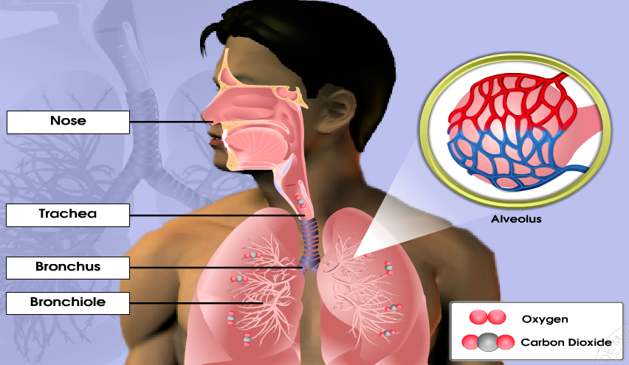
GASEOUS EXCHANGE ACROSS THE SURFACE OF ALVEOLUS & BLOOD CAPILLARIES

Slide 36
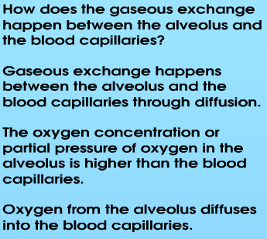
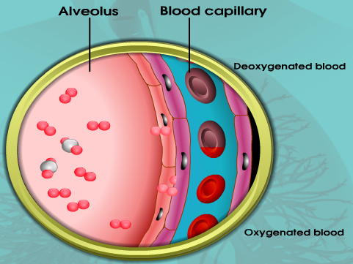

Slide 37
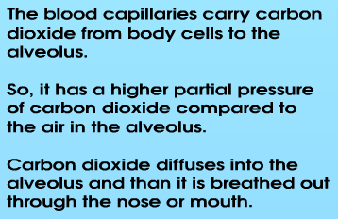
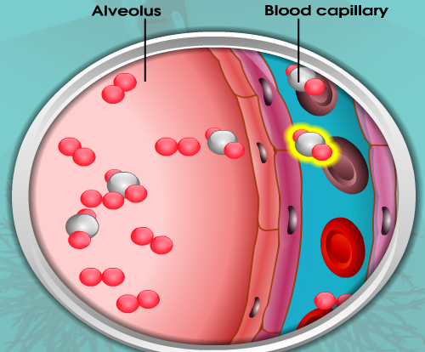

Slide 38
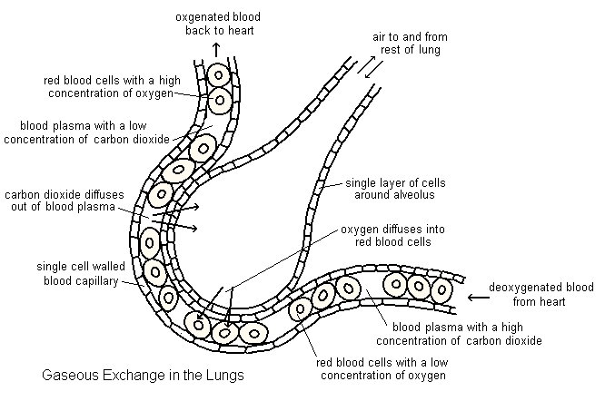

Slide 39
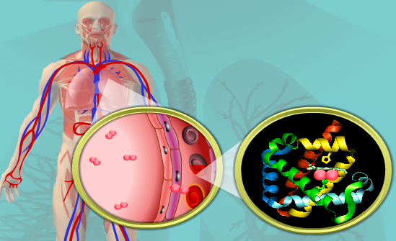
TRANSPORT OF RESPIRATORY GASES IN HUMAN
a) Transport of O2 from lungs to body cell
After the gaseous exchange happens between the alveolus and the blood capillary, the oxygen from the blood capillaries must be transported to the body cells and tissues for cellular respiration. Oxygen combines with haemoglobin to form oxyhaemoglobin. Haemoglobin is the red pigment in red blood cells. Oxygen in the form of Oxyhaemoglobin is carried to the cells and tissues. For the oxygen to dissolve in the cells and tissues that need them.

Slide 40
The oxyhaemoglobin is not stable so, it will be broken down into
haemoglobin and oxygen when it reaches the cell or tissue with low concentration of oxygen.

Slide 41
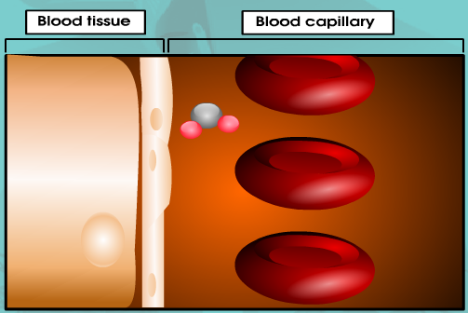
a) Transport of CO2 from body cells to lungs
At the same time carbon dioxide will diffuse into the blood capillary. Carbon dioxide released by respiring cells diffuses into the blood plasma and into the red blood cells. Carbon dioxide can be transported from the body cells to the lungs in three ways: 7% dissolves into the plasma 23% binds to the multiple amino groups of haemoglobin (Carboxyhaemoglobin), and 70% is carried as bicarbonate ions.

Slide 42
The reaction between carbon dioxide with water forms carbonic acid. Carbonic anhydrase, an enzyme in the red blood cells catalyses the reaction.
The carbonic acid then breaks into a hydrogen ion and a bicarbonate ion. The bicarbonate ions diffuse into the blood plasma and carried to the lungs.
In lungs, the process that happens is the reverse of what happens in the tissue.

Slide 43
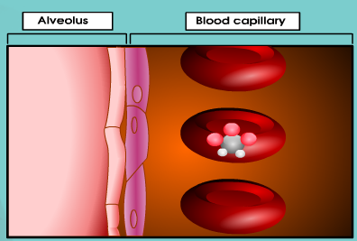

Slide 44
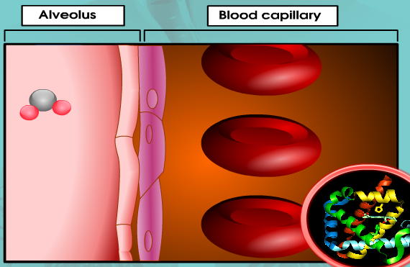

Slide 45
7.4 THE REGULATION MECHANISM IN RESPIRATION
LEARNING OUTCOMES:
Describe the change in the rate of respiration after completing vigorous exercises
Correlate the rate of respiration with the O₂ and CO₂ contents in the body
Explain regulatory mechanism of O2 and CO2 contents in the body
Explain human respiratory response and the rate of respiration in different situations
Correlate the rate of respiration with the rate of heartbeat

Slide 46
CORRELATION RATE OF RESPIRATION WITH O₂ AND CO₂ CONTENTS IN THE BODY
During vigorous exercise, muscles require more O2 and glucose to release E during cellular respiration. So, rate of respiration increase.
Thus, to supply more O2, rate and depth of breathing increase.
At the same time, the heartbeat increase to pump more blood into circulation.
this enables more O2 and glucose to be supplied for cellular respiration and more CO2 removed from the cells.
rate of ventilation increases-is the rate of gaseous exchange between alveoli and blood capillaries

Slide 47
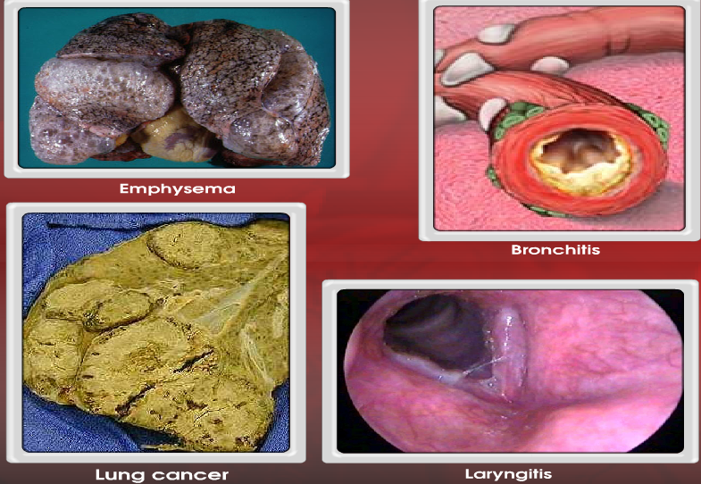
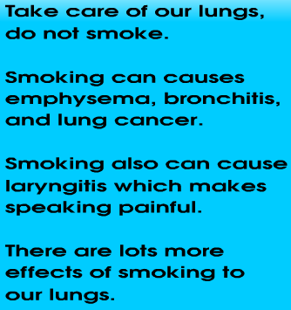
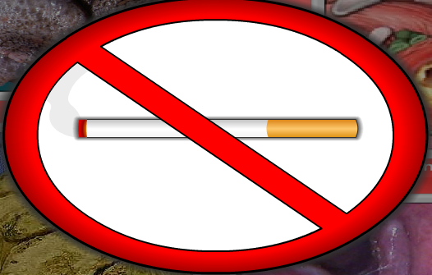
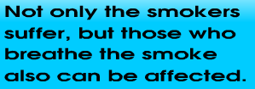
MAINTAINING A HEALTHY RESPIRATORY SYSTEM

Slide 48
RESPIRATION AND PHOTOSYNTHESIS
1. The similarities of photosynthesis and respiration are:

Slide 49
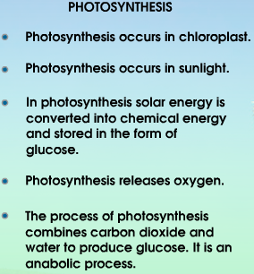
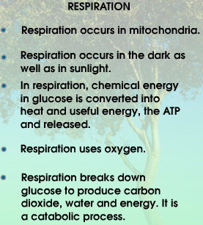
1. The differences of photosynthesis and respiration are:

